Slide 1

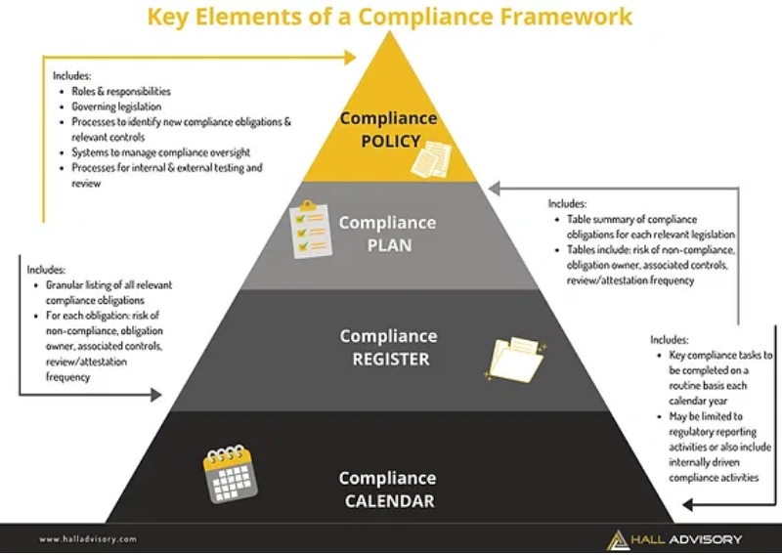
GRC104 - Compliance Frameworks and Legal Requirements
Overview of Global Compliance Frameworks
International Cybersecurity and Digital Forensics Academy
Directorate of Ethics and Discipline
Week 16: Oct 27 - Nov 2, 2025

Slide 2

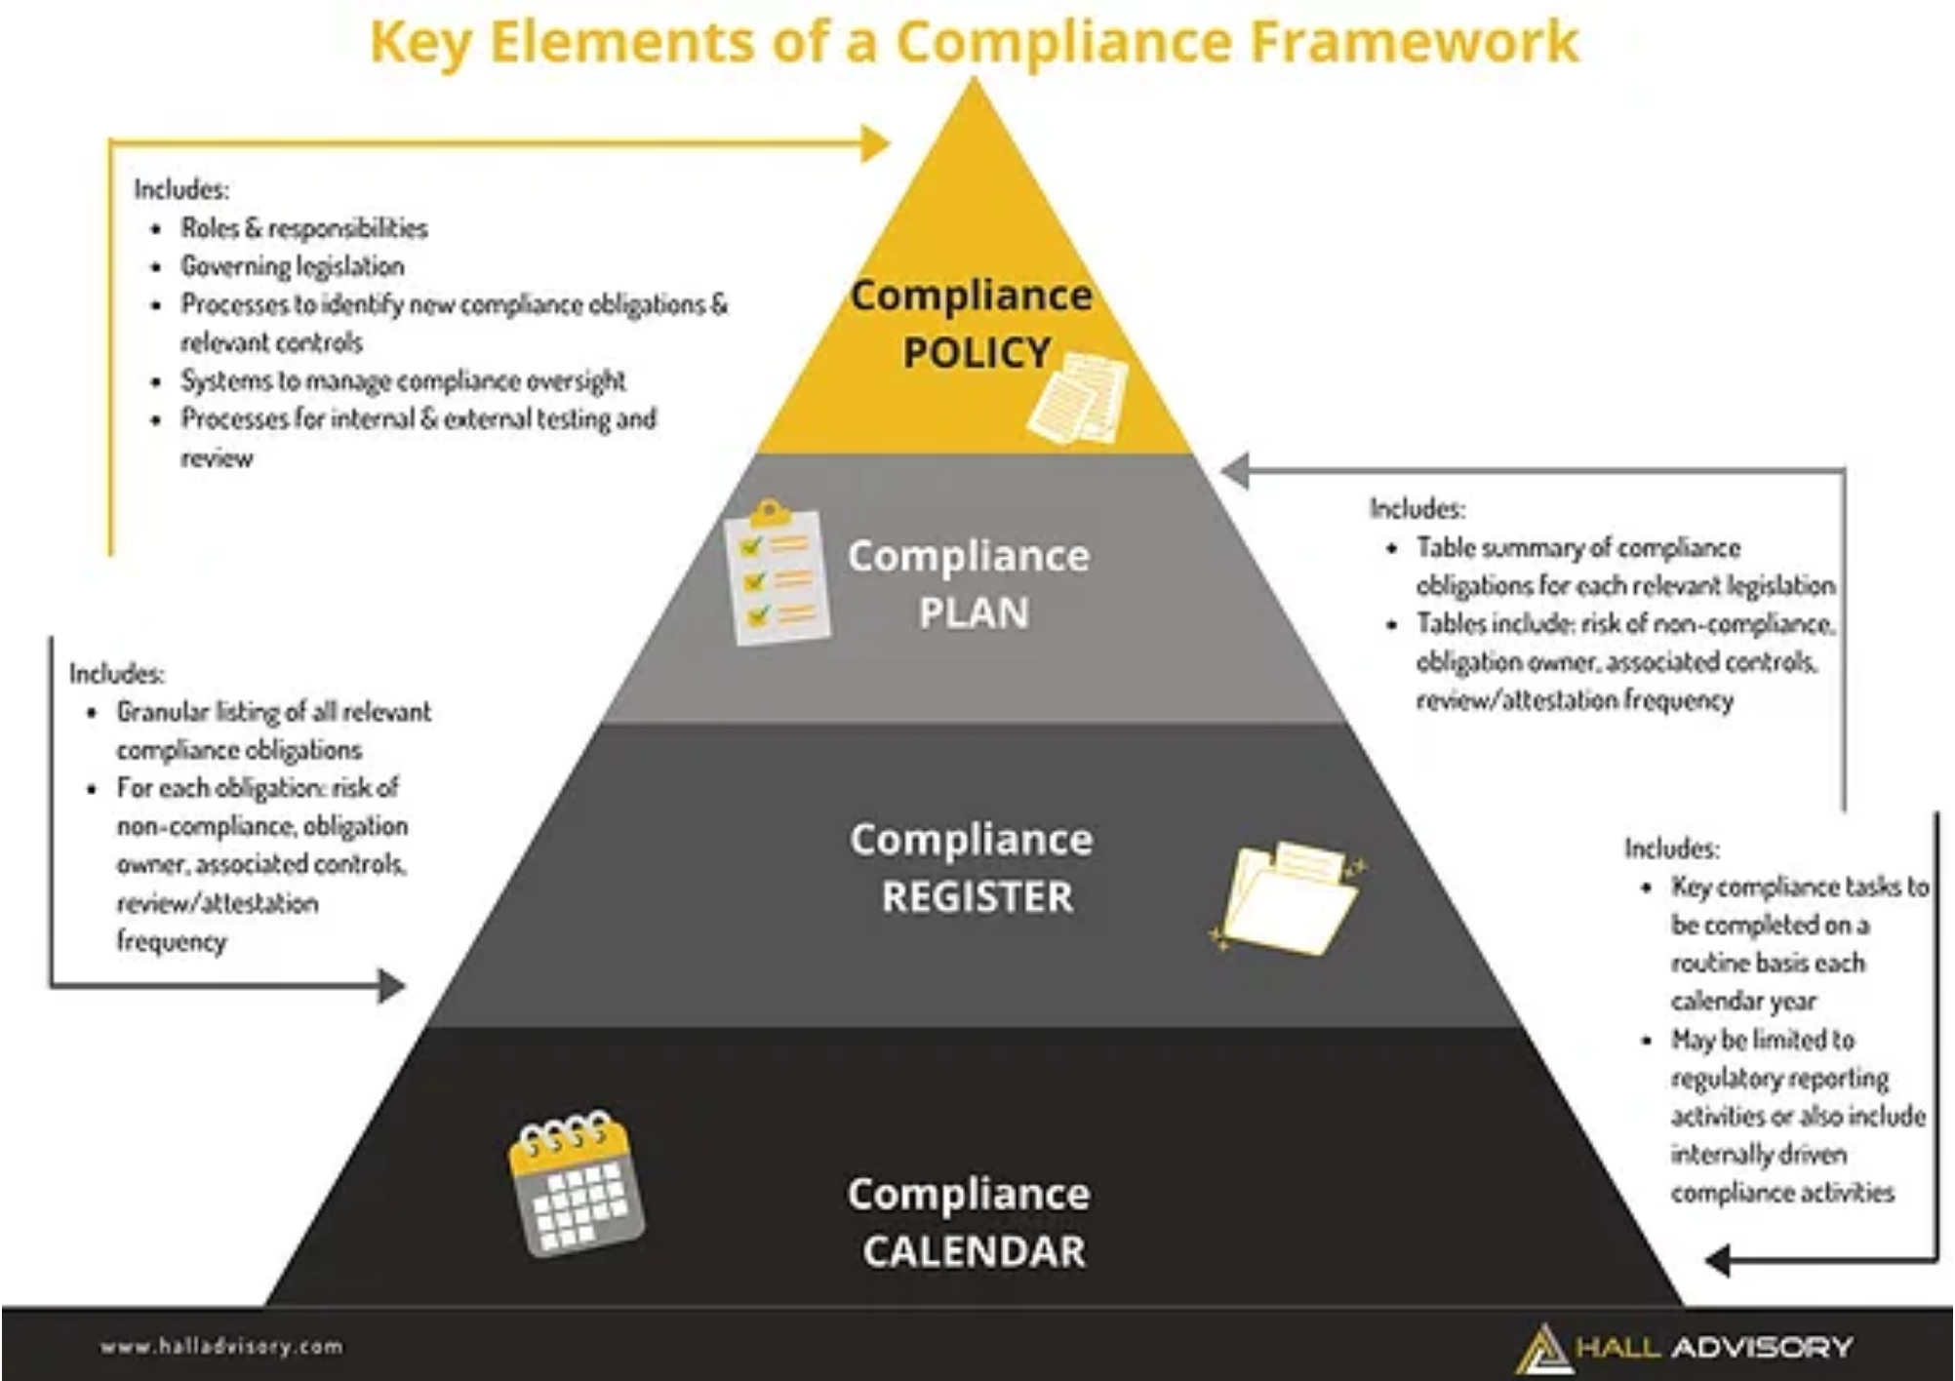
Introduction to Global Compliance Frameworks
What is a Compliance Framework?
A structured set of guidelines, rules, and best practices designed to help organizations manage regulatory requirements systematically and ensure adherence to legal, ethical, and industry standards.
Why Global Compliance Matters:
Mitigate Risks:
Avoid legal penalties, financial losses, and reputational damage
Build Trust:
Enhance stakeholder confidence and market credibility
Operational Efficiency:
Streamline processes and reduce redundancies
Global Reach:
Essential for organizations operating across multiple jurisdictions

Slide 3

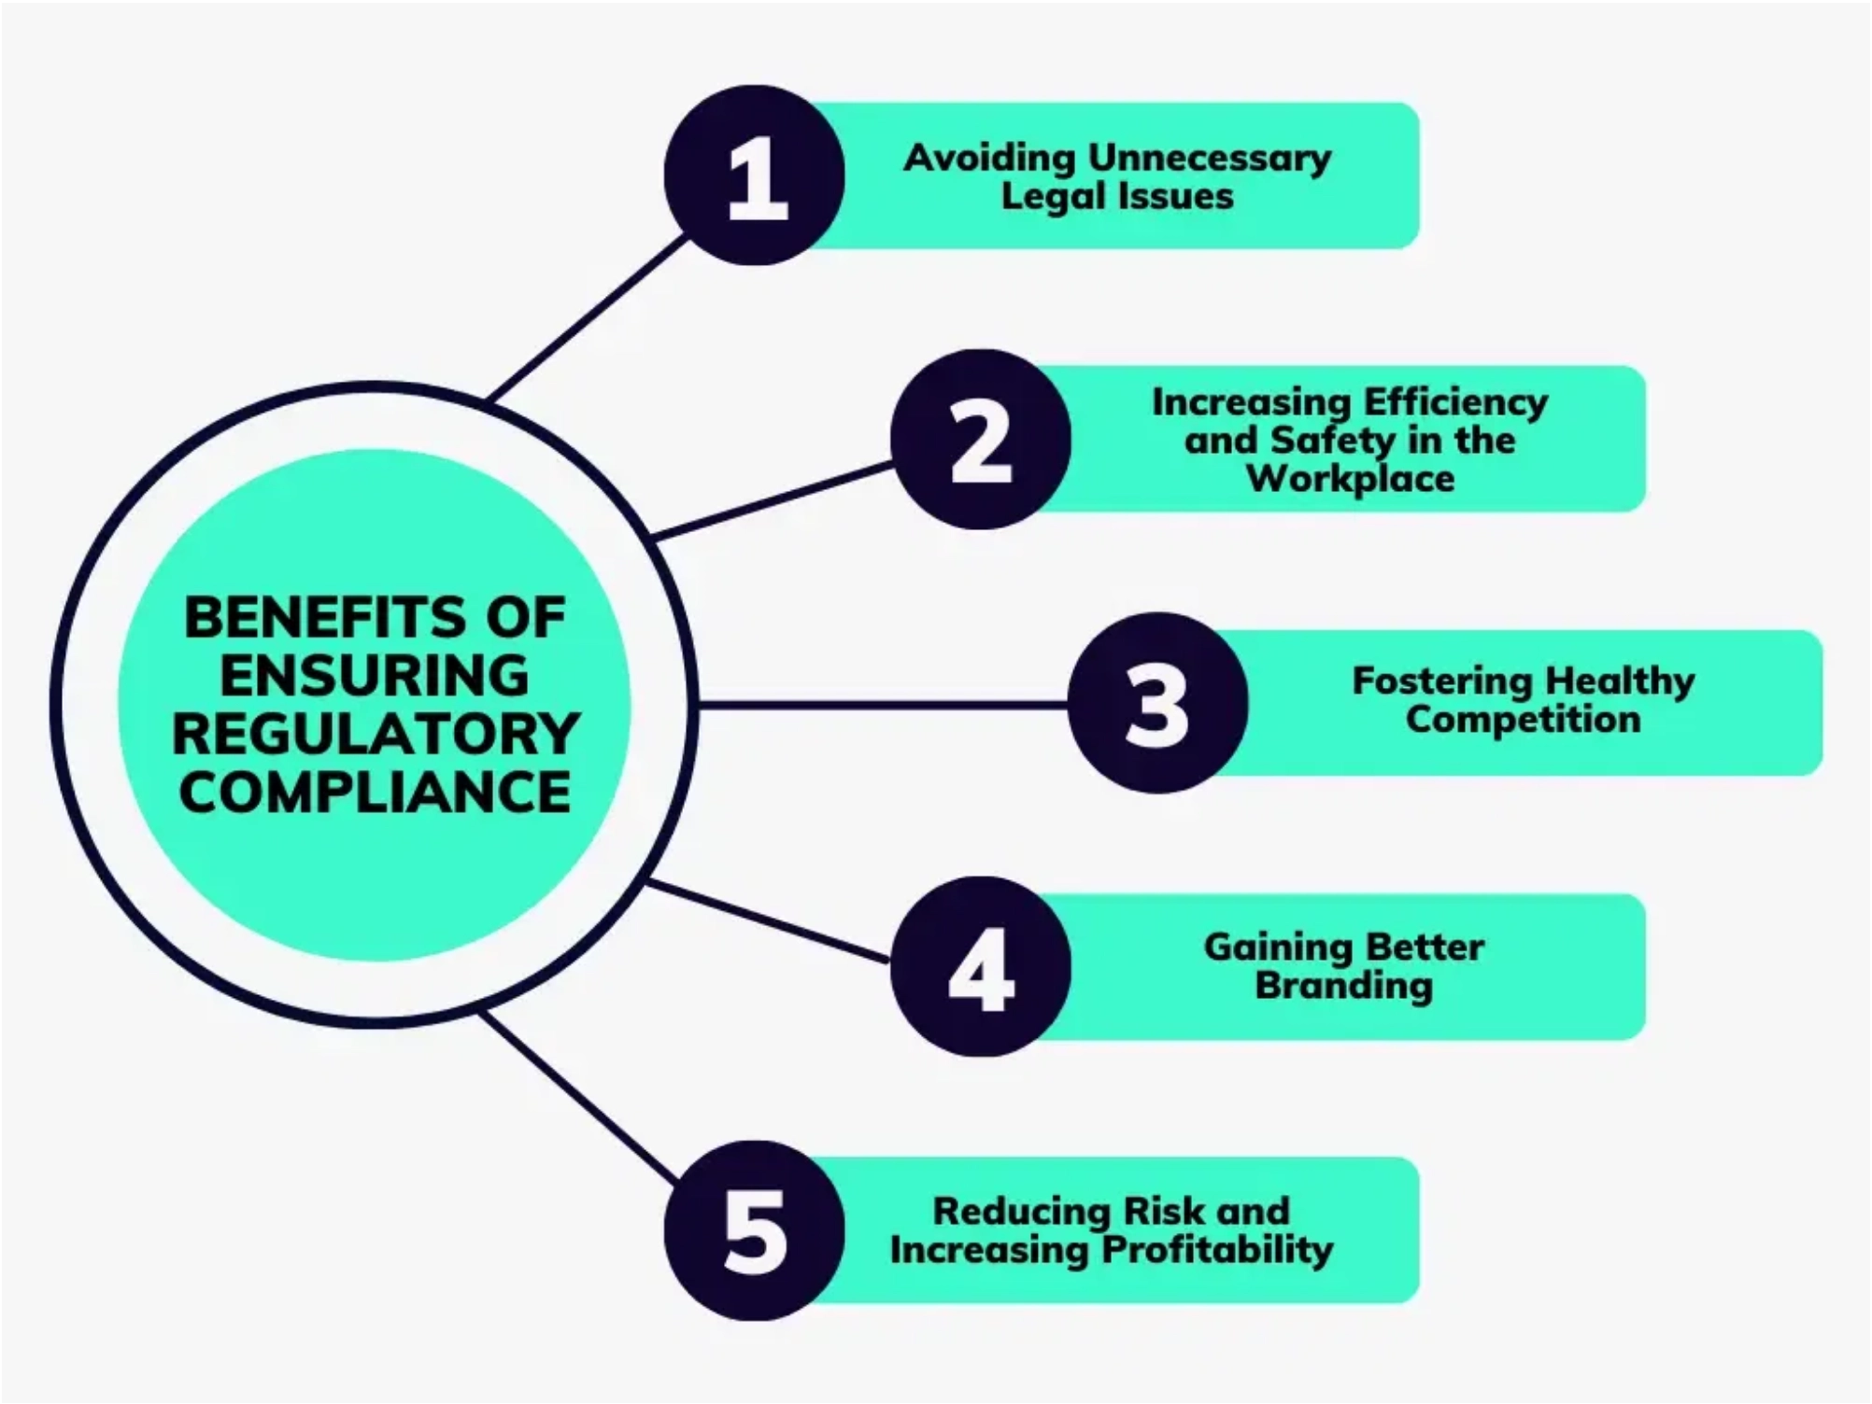



Why Global Compliance Matters
Strategic Importance of Compliance
Benefit
Description
Prevents legal penalties, financial losses, and reputational damage
Risk Mitigation
Competitive Advantage
Builds customer trust and market credibility
Operational Excellence
Standardizes processes and improves efficiency
Global Market Access
Enables operations across multiple jurisdictions
Evolution of Compliance Landscape
Growing regulatory requirements across regions
Heightened focus on data protection and privacy
Increased stakeholder expectations for corporate responsibility

Slide 4

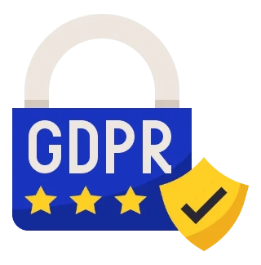

Key Global Regulatory Frameworks (Part 1)
GDPR (General Data Protection Regulation)
HIPAA (Health Insurance Portability and Accountability Act)
The European Union's comprehensive data protection law that reshapes how organizations handle personal data of EU residents, regardless of the organization's location.
U.S. federal law protecting sensitive patient health information from disclosure without consent.
Key Requirements:
Key Requirements:
Privacy Rule (PHI protection)
Legal basis for data processing
Security Rule (electronic PHI safeguards)
Data subject rights (access, erasure, portability)
Breach Notification Rule
Data breach notification within 72 hours
Minimum Necessary Rule
Data Protection Officer appointment
Omnibus Rule (business associate responsibilities)
Privacy by design and default
Penalties:
Range from $100 to $1.5 million per violation
Penalties:
Up to €20M or 4% of annual global revenue

Slide 5


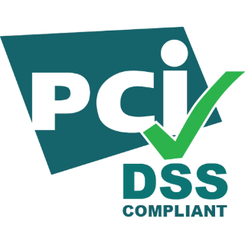


Key Global Regulatory Frameworks (Part 2)
SOX (Sarbanes-Oxley Act)
PCI DSS (Payment Card Industry Data Security Standard)
U.S. federal law enacted in 2002 to improve corporate governance and accountability, preventing accounting fraud following major corporate scandals.
Global security standard for organizations that handle credit card information, designed to protect cardholder data.
Corporate responsibility
for financial reports
Build and maintain
secure networks
Management assessment
of internal controls
Protect cardholder data
in transit and at rest
Strict recordkeeping
requirements
Maintain
vulnerability management
program
Penalties
for wrongful certifications
Implement
strong access control
measures
Enforced by:
Securities and Exchange Commission (SEC)
Regularly monitor and test
networks
Maintain
information security policy
Penalties:
Fines from $5,000-$100,000 per month,
increased transaction fees, or termination of card payment
acceptance

Slide 6

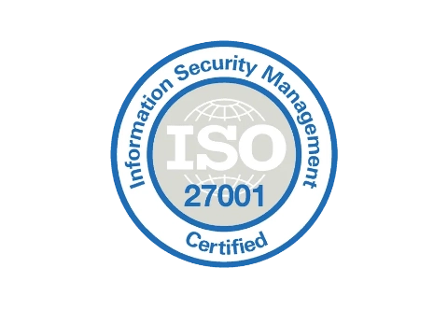
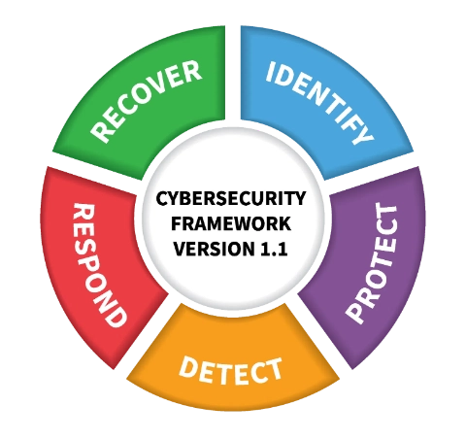
Key Global Information Security Frameworks (Part 1)
ISO/IEC 27001
NIST Cybersecurity Framework
International standard for Information Security Management Systems (ISMS), providing a systematic approach to managing sensitive information.
Developed by the U.S. National Institute of Standards and Technology, this framework provides a flexible, organized approach to managing cybersecurity risk.
Risk assessment and treatment
methodology
Leadership commitment
to information security
Identify
Protect
Detect
Respond
Recover
93 security controls
across organizational, people, physical, and technological domains
Certification valid for 3 years
with annual surveillance audits
Flexible implementation
adaptable to organizations of all sizes
Continuous improvement
through Plan-Do-Check-Act cycle
Risk-based approach
to prioritize cybersecurity activities
Key Benefit:
Internationally recognized standard that demonstrates
Common language
for cybersecurity discussions
commitment to information security best practices
Integration
with business and organizational needs
NIST CSF 2.0
will add "Govern" as sixth core function
Key Benefit:
Adaptable framework that can be tailored to specific
organizational risk profiles and business needs

Slide 7

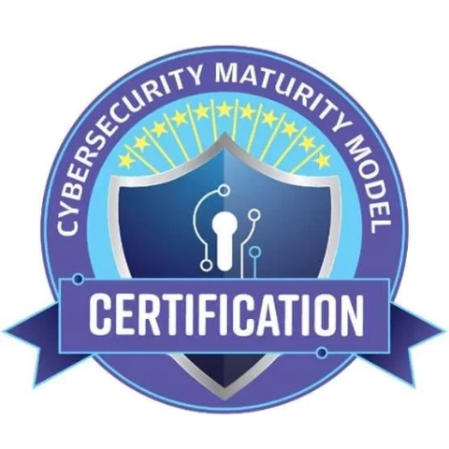
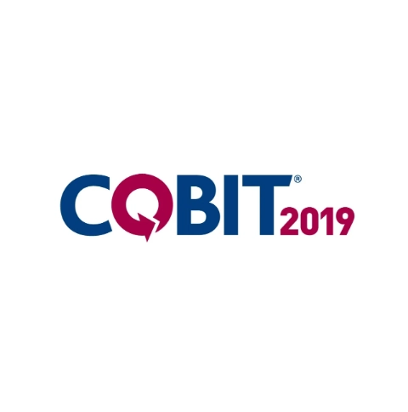
Key Global Information Security Frameworks (Part 2)
COBIT (Control Objectives for Information and Related Technologies)
CMMC (Cybersecurity Maturity Model Certification)
Designed for the U.S. Department of Defense supply chain to enhance protection of sensitive defense information.
Developed by ISACA, COBIT aligns IT governance and management with business objectives.
1
Foundational
- Basic cybersecurity practices, may be
Governance and management objectives
for enterprise IT
implemented ad-hoc
Performance management
2
Advanced
- Documented, repeatable processes with intermediate
through metrics and maturity models
cybersecurity
Risk optimization
strategies and frameworks
3
Expert
- Strategies for advanced persistent threats and
sophisticated attacks
Resource optimization
for IT investments
Implementation Timeline: Mandatory for DoD contractors by 2026
Stakeholder value delivery
through balanced decision-making
Primary Focus: Bridging the gap between business requirements, control needs, and technical issues

Slide 8

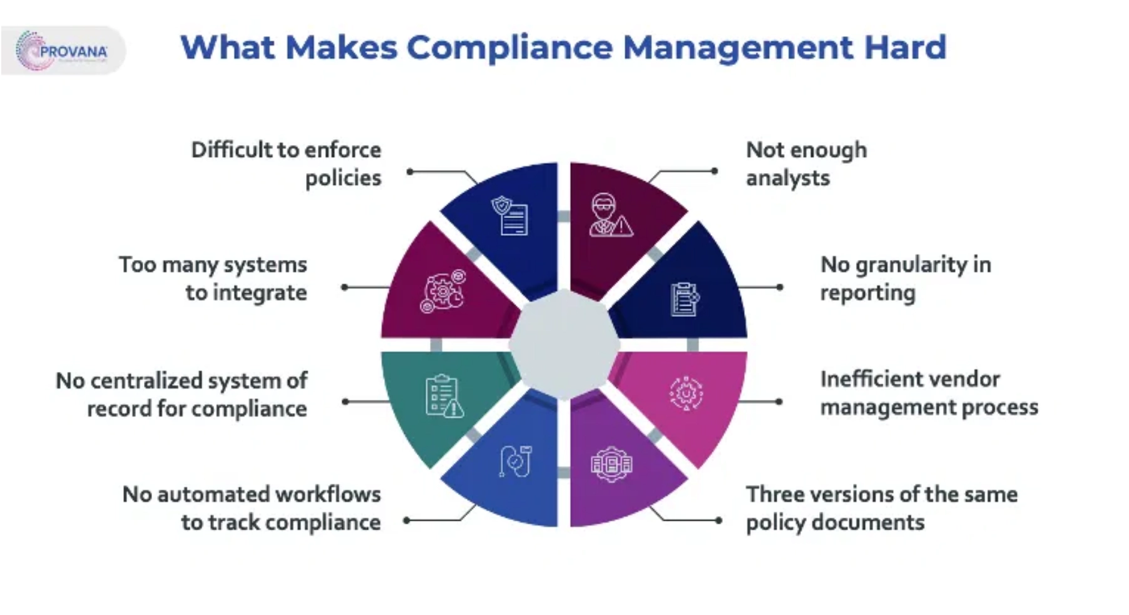



Challenges in Global Compliance
Key Obstacles Organizations Face
Challenge
Description
Regulatory Complexity
Navigating regulations across different jurisdictions
Keeping pace with rapidly changing laws and standards
Constant Evolution
Resource Constraints
Allocating sufficient budget, personnel, and expertise
Technology Integration
Implementing effective monitoring systems
Impact of Non-Compliance
Financial penalties
Reputational damage
Market access restrictions

Slide 9

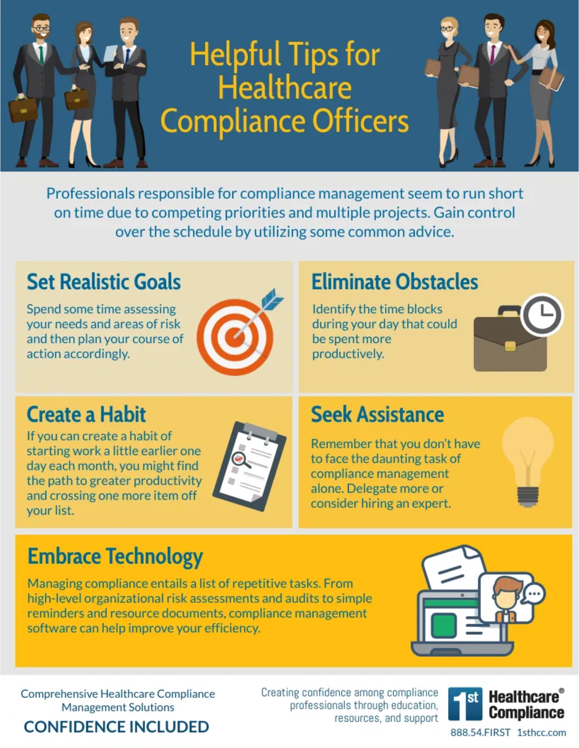





Best Practices for Global Compliance
Strategic Approaches to Effective Compliance
Risk-Based Approach
Prioritize compliance efforts based on risk assessment, focusing resources on areas with the highest potential impact and likelihood of occurrence.
Integrated GRC Framework
Implement a unified Governance, Risk, and Compliance strategy rather than managing compliance requirements in silos, enabling better visibility and coordination.
Technology Enablement
Leverage GRC platforms and automation tools to streamline compliance processes, improve monitoring capabilities, and generate comprehensive reports.
Culture of Compliance
Foster an organization-wide commitment to compliance, starting with leadership's tone at the top and extending through regular training and awareness programs.
Continuous Monitoring
Implement real-time monitoring systems to detect non-compliance issues promptly, allowing for timely remediation and process improvement.

Slide 10






Conclusion & Key Takeaways
Summary of Global Compliance Frameworks
Critical Success Factors
Global compliance frameworks provide essential structure for organizations navigating complex regulatory environments.
Proactive Approach
Rather than reactive response to regulatory requirements
The
fundamental purpose
of compliance frameworks in today's global business landscape
Key regulatory frameworks including
GDPR, HIPAA, SOX, and PCI DSS
Executive Sponsorship
ISO 27001, NIST CSF, COBIT, and CMMC
Clear accountability for compliance outcomes
Major information security frameworks such as
Common
challenges
organizations face in achieving global compliance
Integrated Systems
Best practices
for implementing effective compliance programs
Comprehensive visibility across the organization
Continuous Improvement
Regular assessment and adaptation
Questions & Discussion

Slide 11




Thank You & Resources
Further Resources
Official Framework Documentation
GDPR
HIPAA
SOX
PCI DSS
ISO 27001
NIST CSF
COBIT
CMMC
Recommended Reading
"The Compliance Handbook: A Guide to Operationalizing Your Compliance Program"
"IT Governance: An International Guide to Data Security and ISO 27001/ISO 27002"
"NIST Cybersecurity Framework: A Practical Implementation Guide"
Thank you for your attention!

